Slide 1
E-Commerce Clothing Website
A Seamless Online Shopping Experience
Name: Anjeet Patel
Reg No: 12210752
Course: INT-252
Roll No: 48
Section: K22MB

Slide 2
Introduction
The Sahu Garments Website aims to provide a seamless online shopping experience with a diverse range of clothing options for all demographics. It emphasizes convenience, style, and accessibility for users worldwide.

Slide 3
Technologies Used
React: Component-based development and state management.
Tailwind CSS: For efficient styling and responsive design.

Slide 4
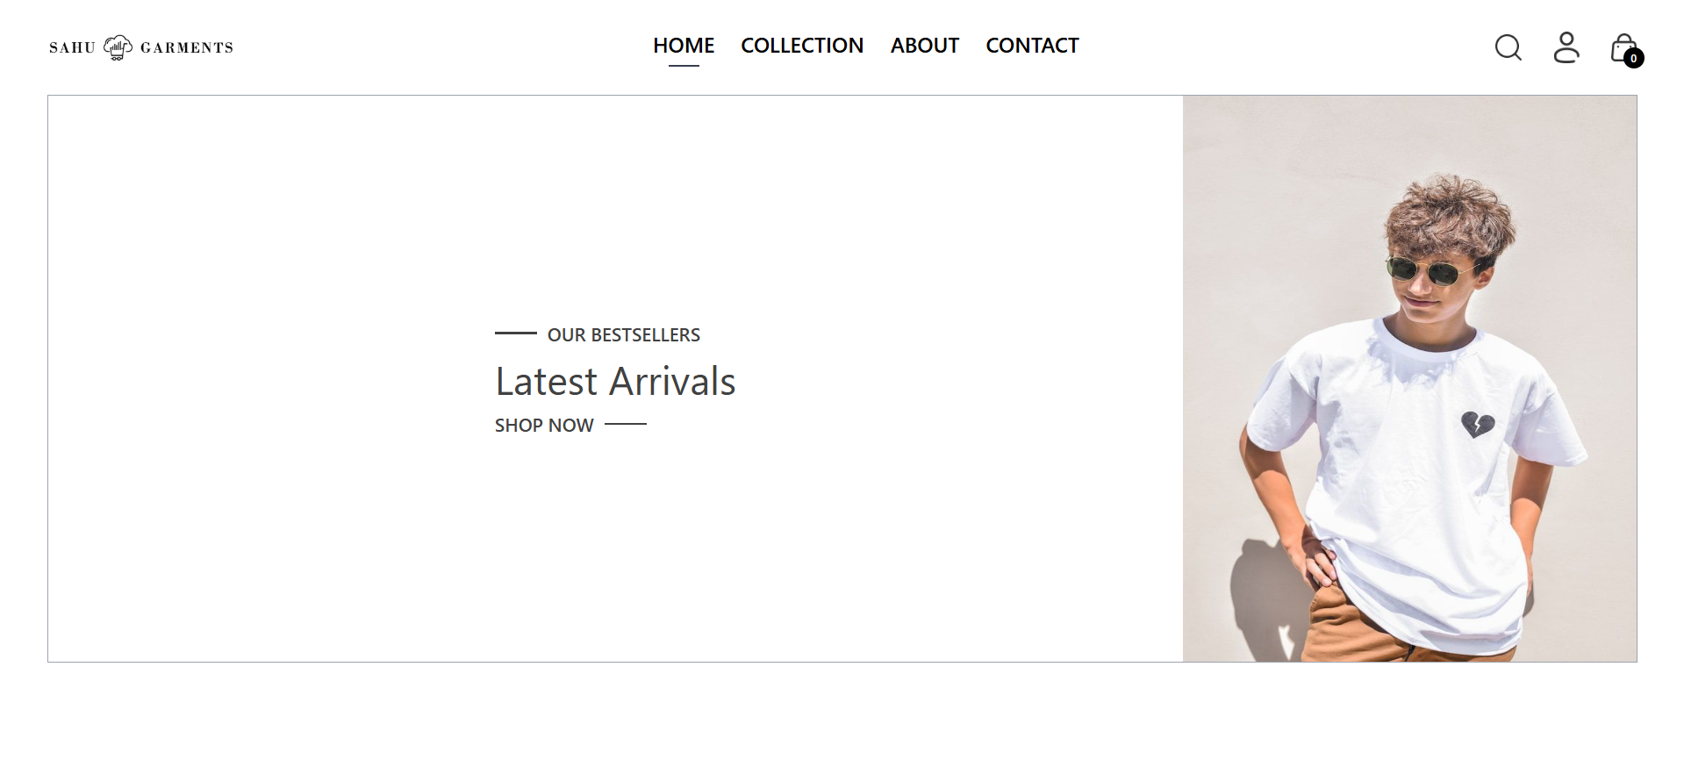

Slide 5
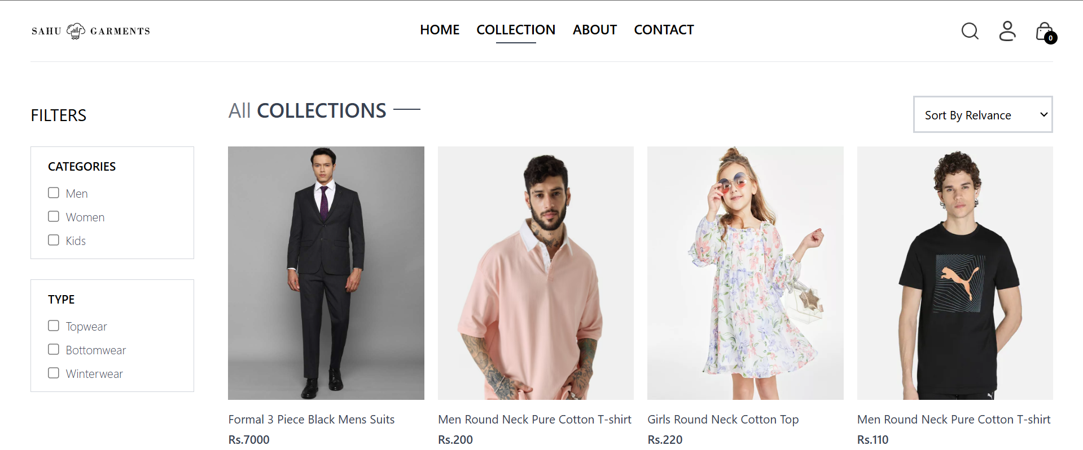

Slide 6
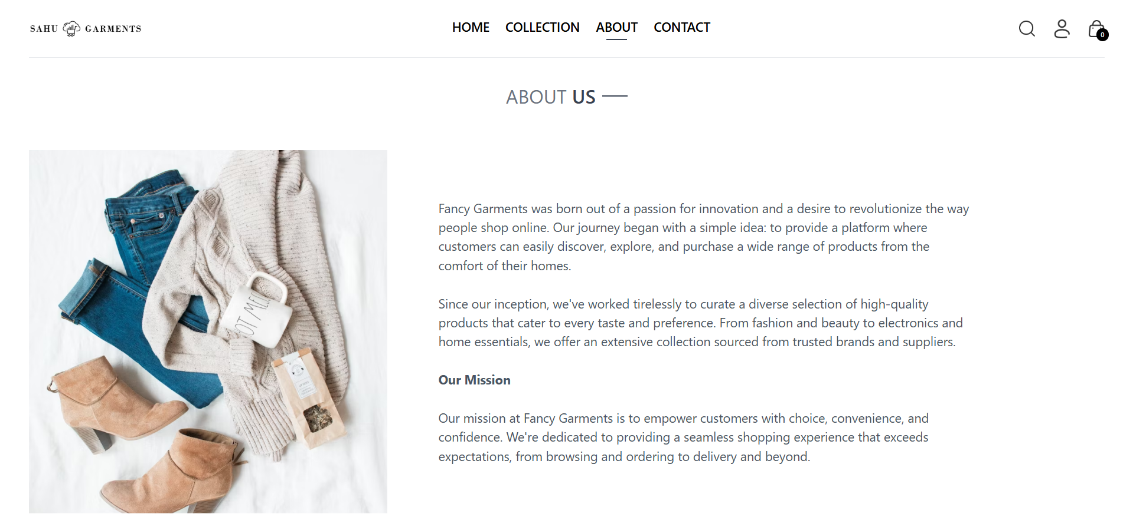

Slide 7
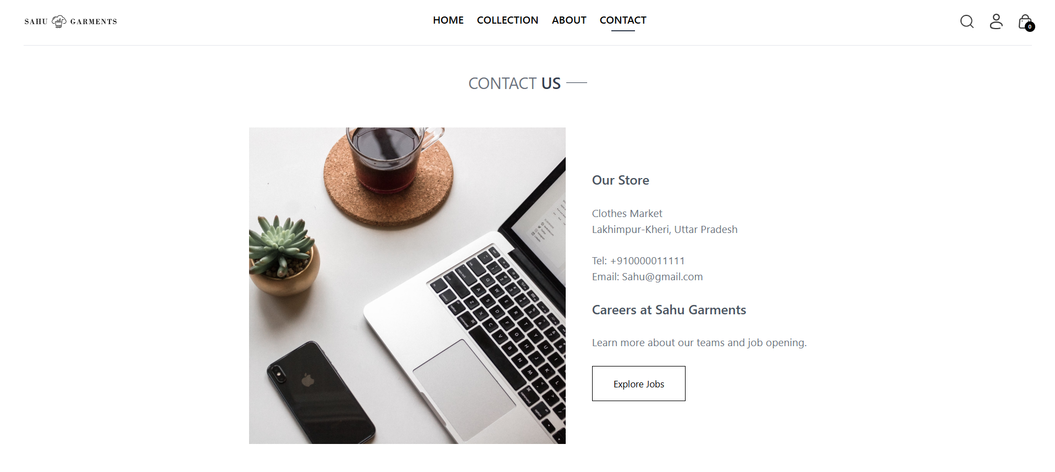

Slide 8
Why Choose This Platform?
- Easy to navigate interface
- Wide variety of products
- Secure payment options
- Exceptional customer service

Slide 9
Functionality
- Product Listings: Category-wise display of clothing
- Search and Filters: Advanced options for easy navigation
- Secure Payments: Multiple payment gateway integration

Slide 10
Benefits
- Increased accessibility for customers worldwide
- Enhanced customer engagement through personalized recommendations
- Secure and convenient shopping environment

Slide 11
Workflow Diagram
1. User logs in
2. Searches for products
3. Adds to cart
4. Proceeds to checkout
5. Completes payment and order

Slide 12
Conclusion
The E-Commerce Clothing Website is designed to revolutionize the shopping experience for customers, providing them with convenience, style, and security while offering businesses enhanced tools for management and growth.

Slide 13
Thank You

